Slide 1




Respects The Globe, Respected Globally
Body Liner Counting @ Thermoforming Machine No#3
Project Performed by: Abu Bakr Siddique
14th - 21st Nov 2023

Slide 2
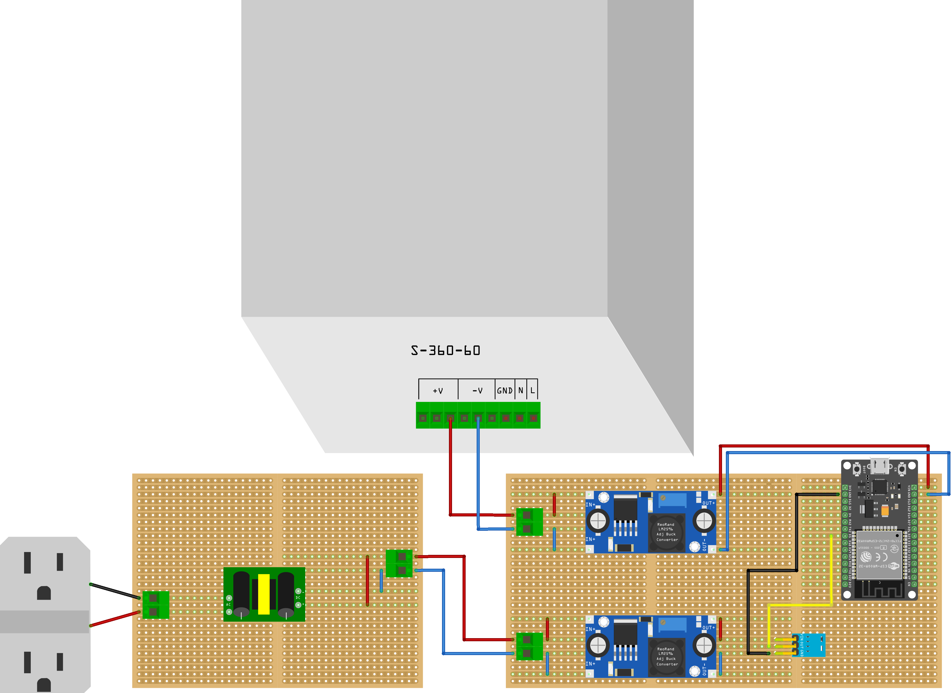
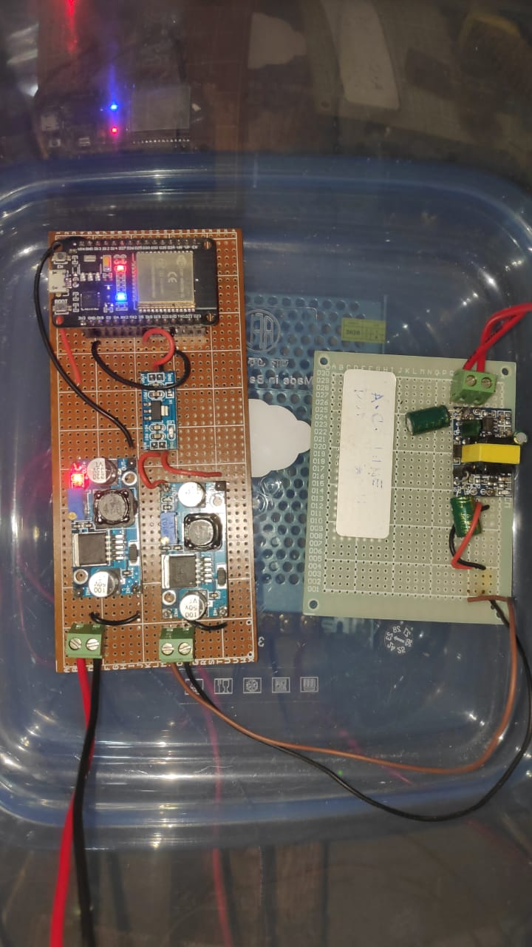



Hardware Overview
List of Items:
12V, 5A Power Supply: x1
LM2596: x2
ESP32DEVKIT DOIT V1: x1
12V AC-DC Buck Regulator: x1
AMS1117: x2
Veroboard/ StripBoard: x2
Wires
12V, 5A Power Supply
12V, 0.7A
AC-DC Buck Regulator
ESP32 DEVKIT DOIT V1
LM2596 – 12 to 5V Regulator
AMS1117 – 5V to 3.3V regulator
LM2596 – 12 to 5V Regulator

Slide 3
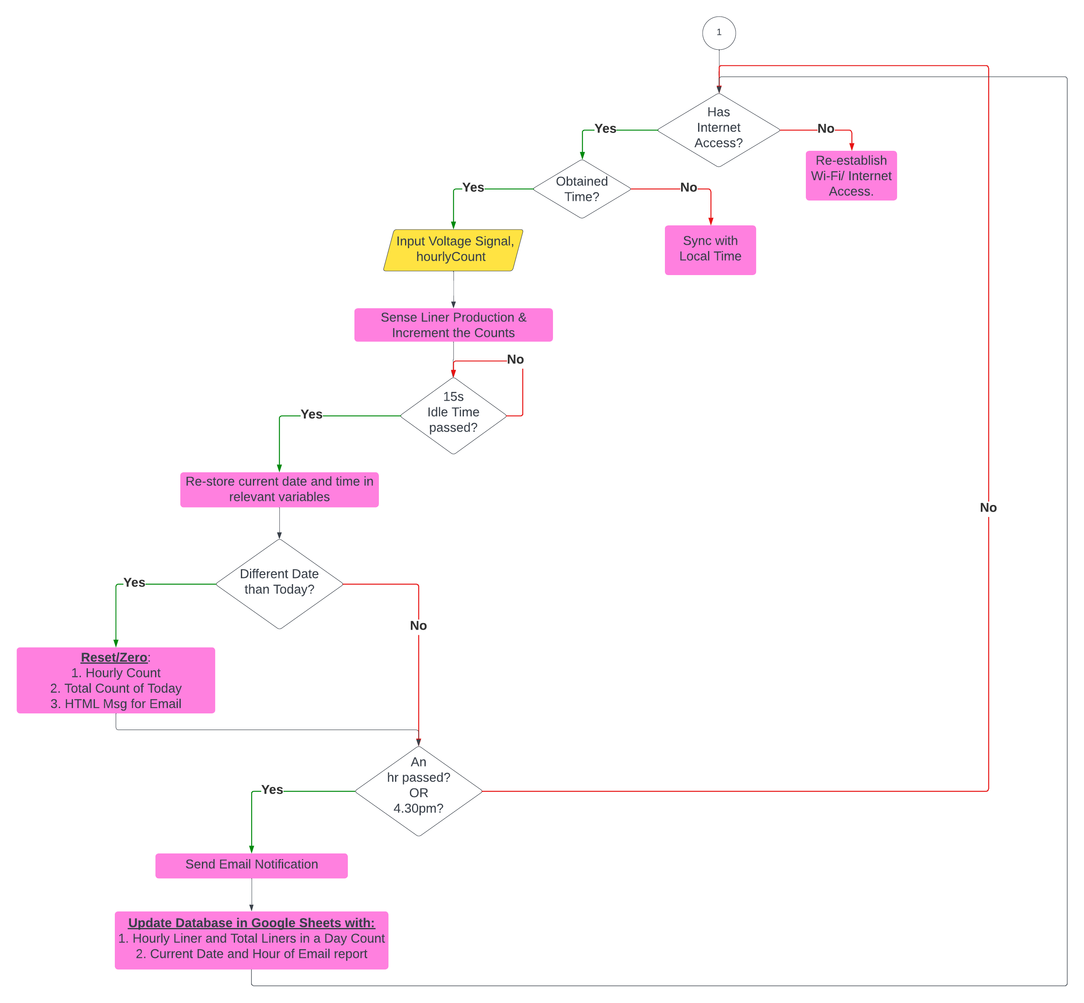
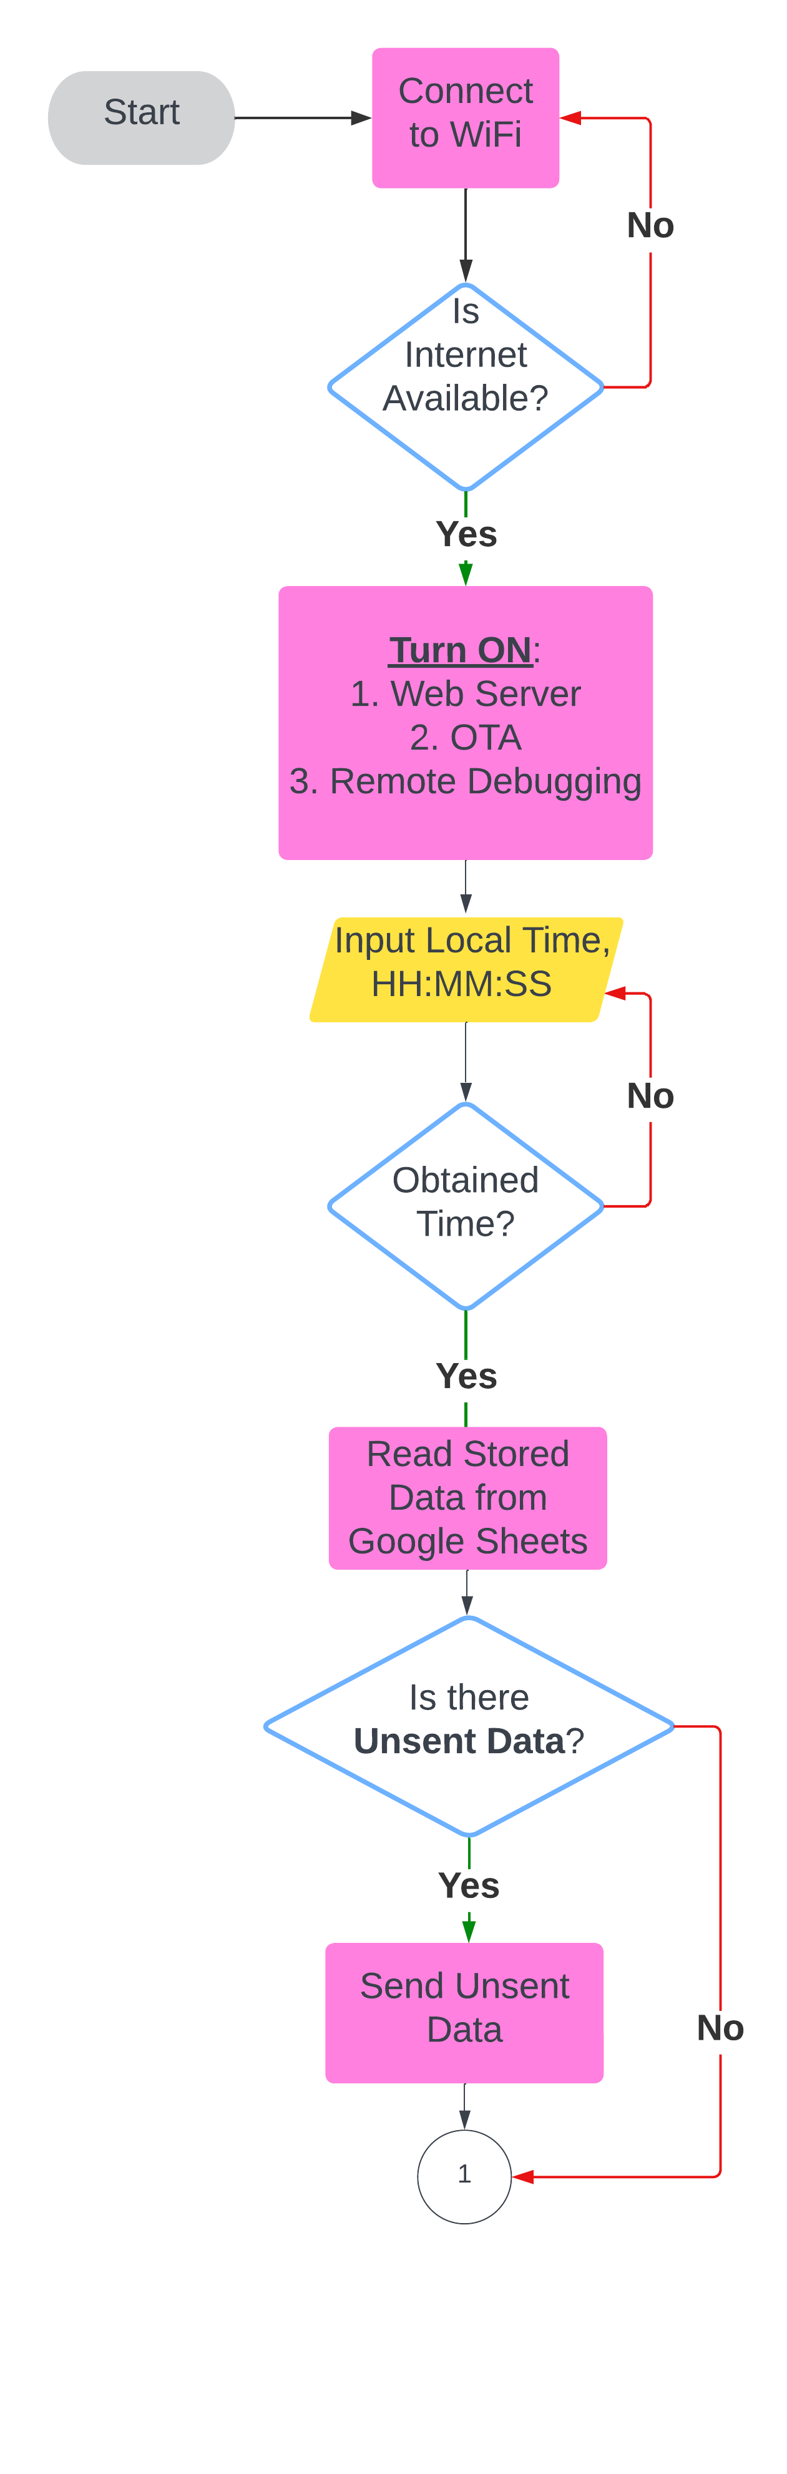
Flowchart

Slide 4



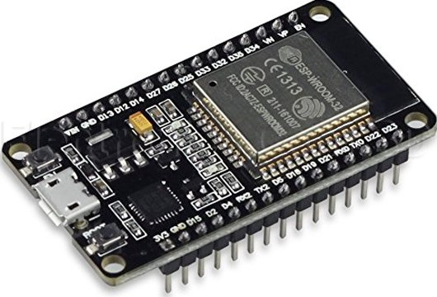



Pipeline Overview
End-to-End IoT Data Pipeline – ESP32, Google Sheets, IFTTT and AppScript
Connect to Wi-Fi
1
Trigger the Webhook, to send JSON data* to Google Sheets.
2
Send the JSON data* to store it in Google Sheets
3
4
Request to read the data from Google Sheets
5
AppScript sends the requested data to ESP32
6
Google AppScript
Send Hourly Email
*Note: JSON Data contains – hourly Liner Counts, Total Liner Counts, Total Liner Counts Saved in previous hour, Today’s date and Last Uploaded Hour

Slide 5

Field-Test Results
Pitfalls & Potential Problems:
Occasional Internet Connectivity
Test Runs = Additional SFG* Counts
V1 (-59.1%)
V2 (-16.4%)
V3 (0%) – may vary by 1 or 2 liners maximum
*Note: SFG – Semi Finished Goods. They are the outcomes or individual products from each section of the factory e.g. Body Liners (FF and FRZ) or Door Liners (Upper and Lower Door) are SFG of Thermoforming.

Slide 6
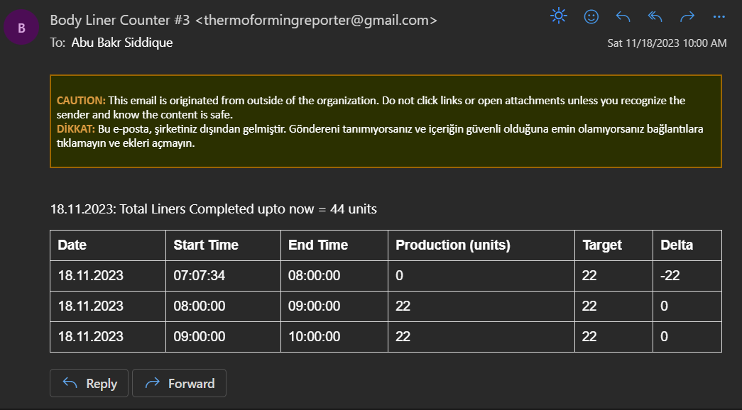
Output Overview

Slide 7
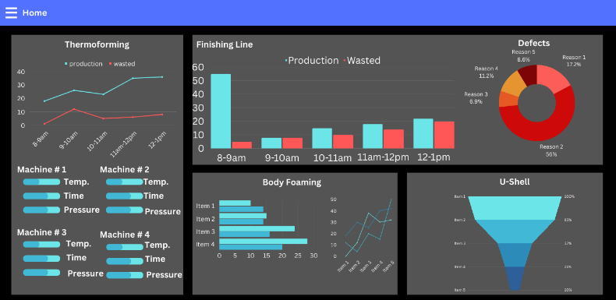
Further Development
Dashboard
Model-Based Counting System
Wastage Counting System
Collection of Data for Big Data Analytics
Avoid Counting Test Runs
Dashboard Containing all the data

